Slide 1


Deploying a Static Website Under Storage Account
PRESENTED BY:
MUDDASANI ASHVITHA
TATICHETTU BHARADWAJ
AMURAM SHINJITH REDDY
KARNATI SAHITHI

Slide 2
INTRODUCTION
Hosting a static website on Azure Storage is a straightforward, cost-effective solution for lightweight web applications like personal blogs, portfolios, or documentation. This guide walks you through the process of creating and deploying a static website using Azure's Storage Account service.

Slide 3
Overview: Key Concepts: Azure Storage Account: The foundational resource that stores website content. Static Website Feature: A special feature that enables direct hosting of static files from the Azure Storage Account. $web Container: A designated container within the Storage Account that hosts website files. Primary Endpoint: A public URL that provides access to the static website.

Slide 4
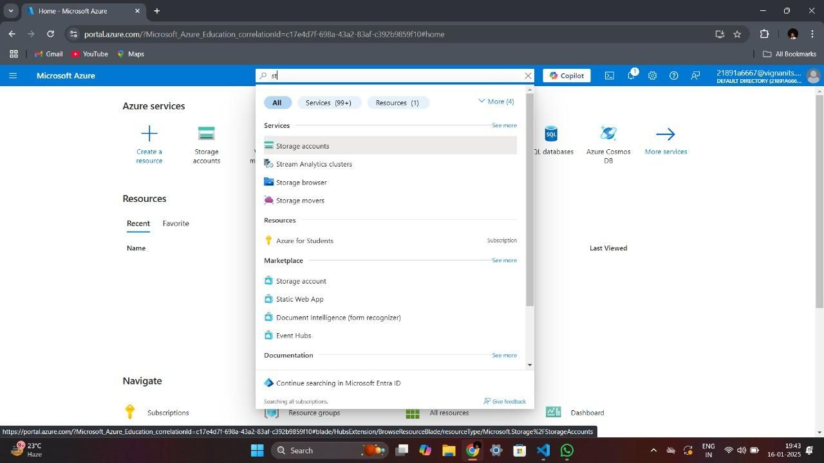
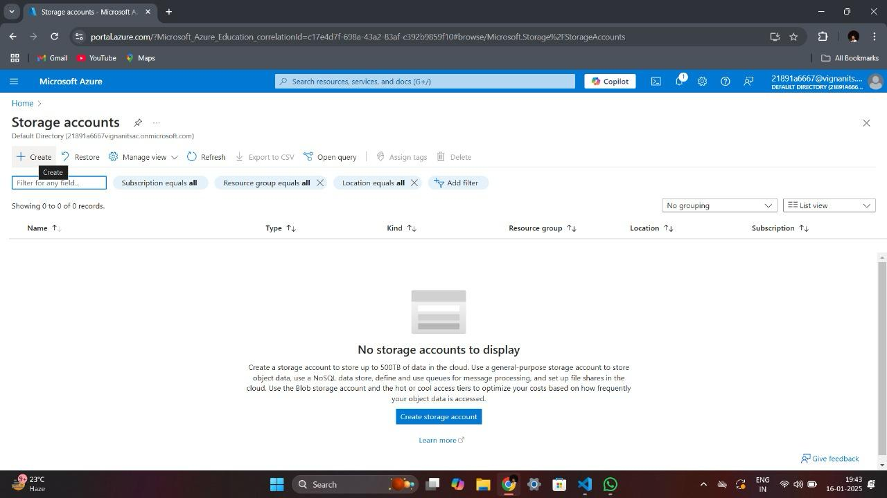
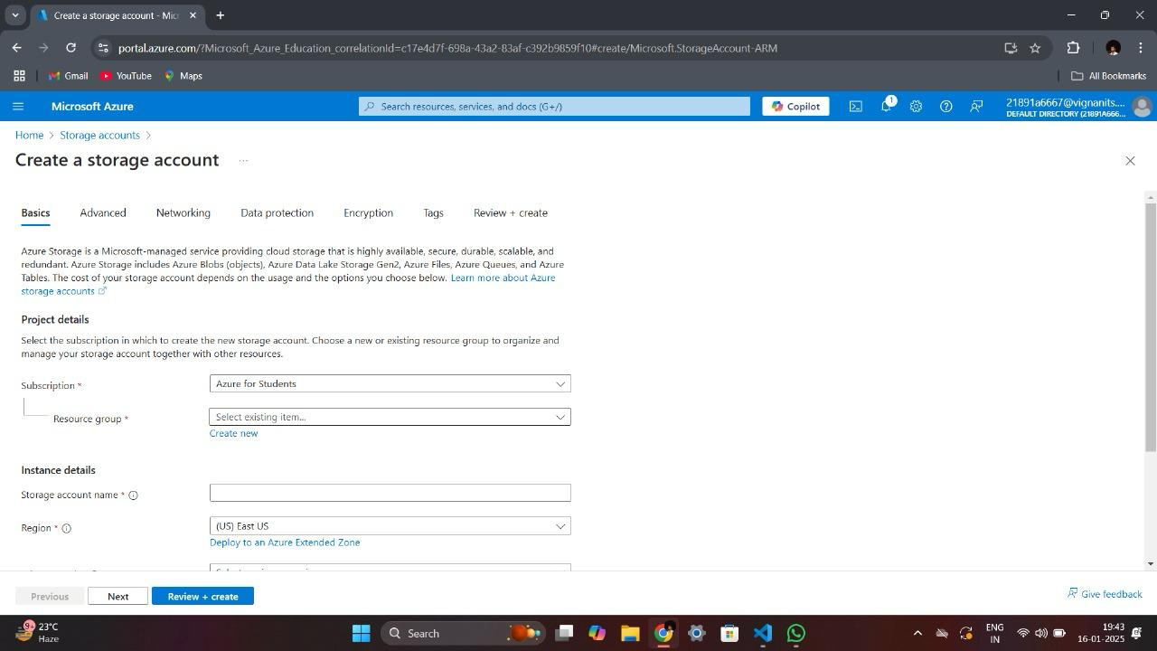
IMPLEMENTATION
Create a Storage Account:
Choose a subscription, resource group, and region to create the Storage Account.
Configure the performance and redundancy options.
Complete the creation process through the Azure Portal.

Slide 5
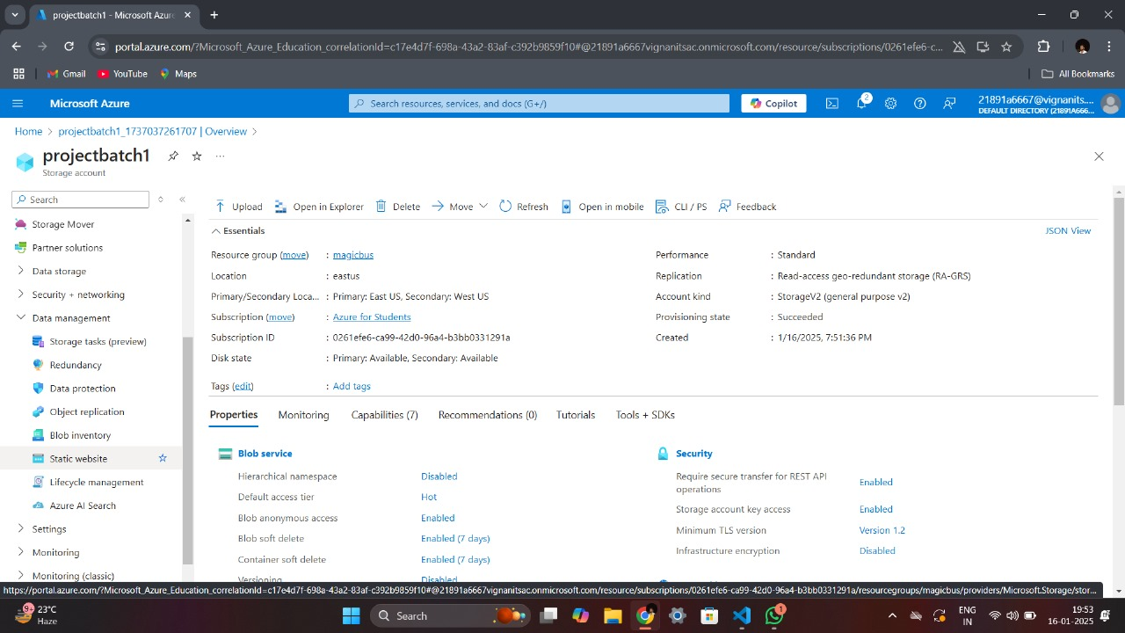
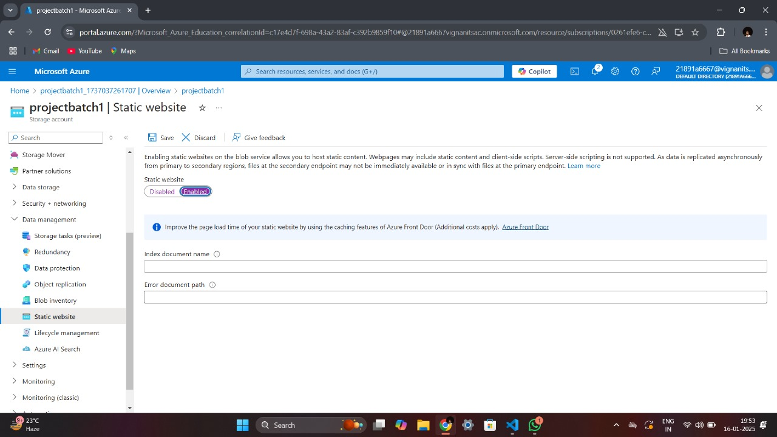
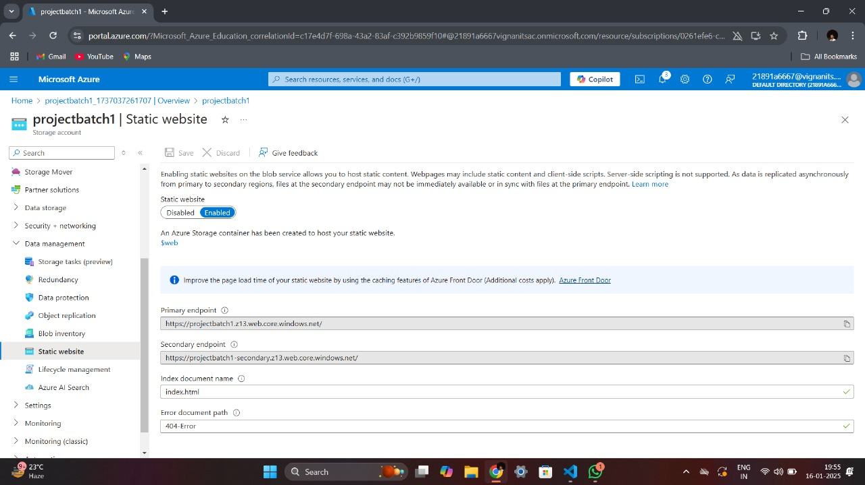
Create a Web Page:
Develop an HTML file
Add content, styling, and structure for the static website.
Enable Static Website Hosting:
Enable the Static Website feature within the Storage Account.
Specify the index document

Slide 6
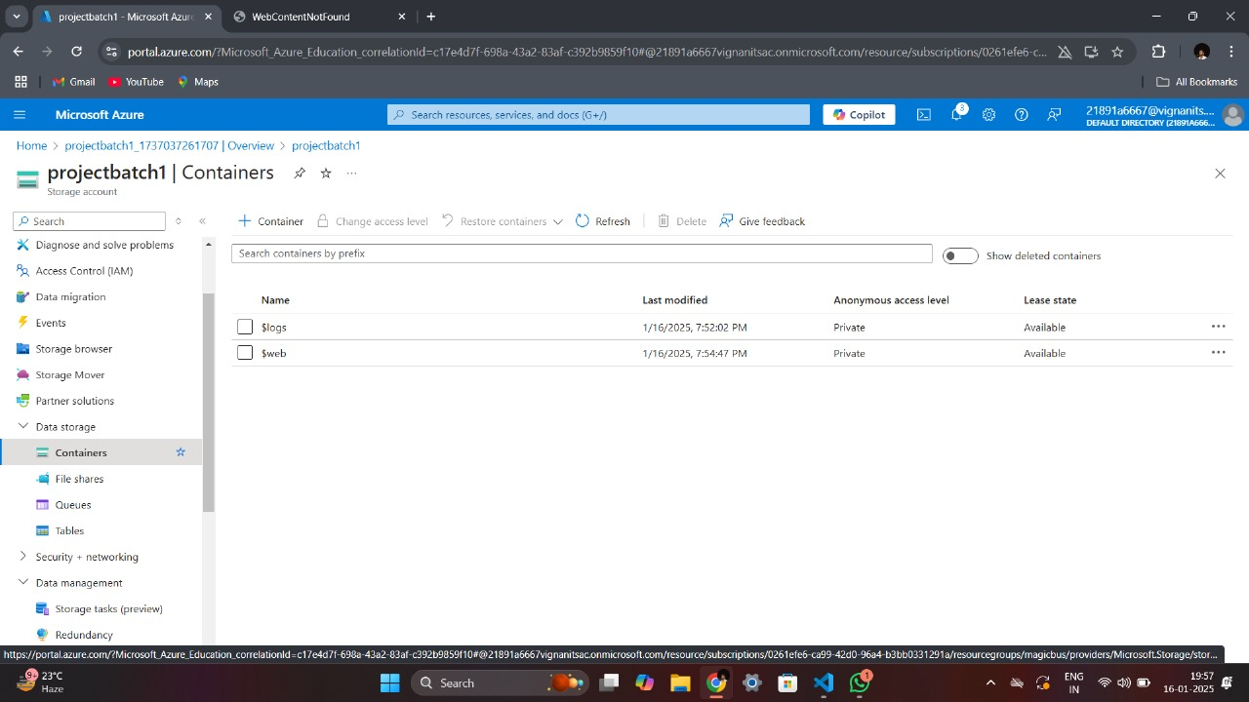
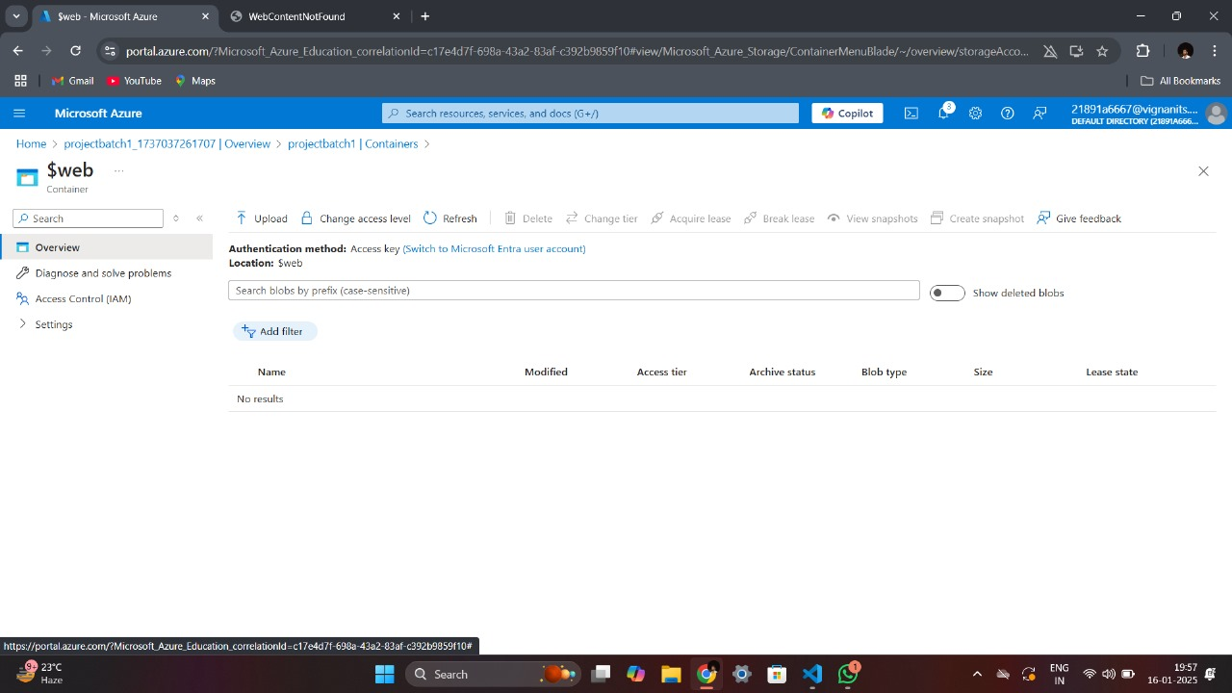
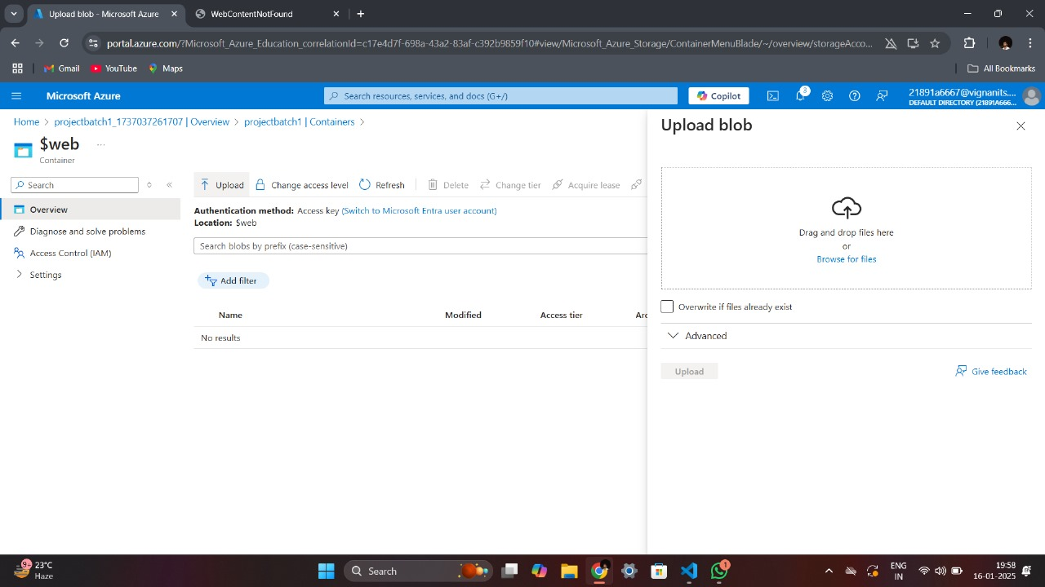
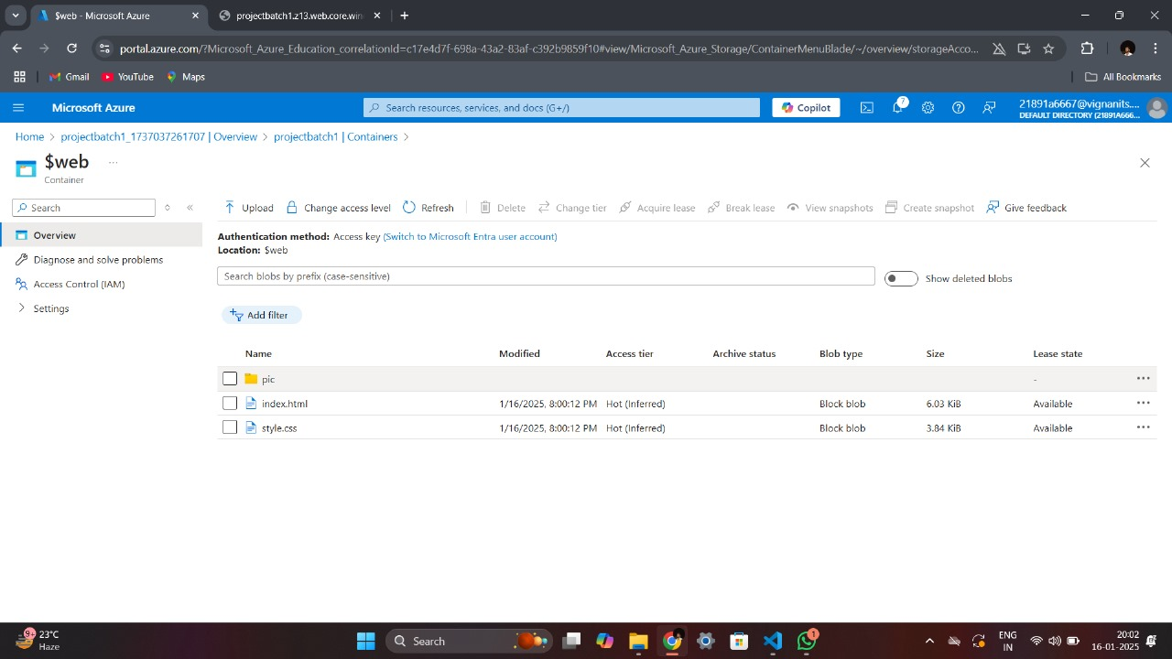
Upload Website Files:
Access the $web container in the Storage Account.
Upload the website files (HTML, CSS, images) using drag and drop or manual upload.

Slide 7
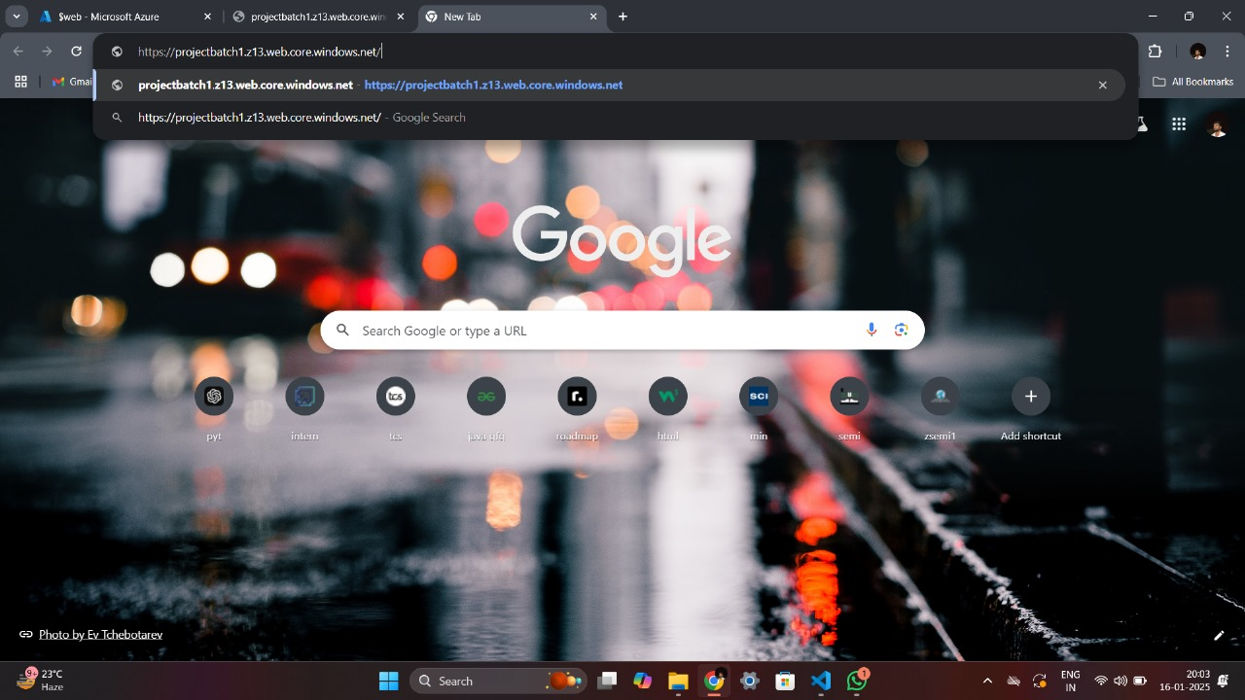
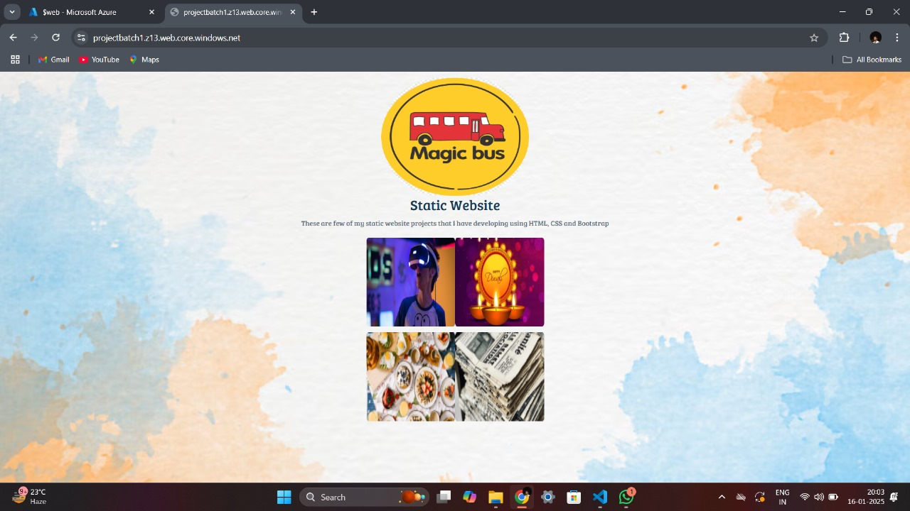
Test the Static Website: Retrieve the Primary Endpoint URL from the Static Website settings. Paste the URL into a browser to ensure proper deployment.

Slide 8
Benefits of Using Azure for Static Websites: Cost-Effective: Minimal hosting costs compared to traditional web hosting services. Scalability: Automatically scales to handle traffic spikes without additional setup. High Availability: Built-in redundancy ensures high uptime. Global Reach: Azure's global data centers ensure fast content delivery to users worldwide.

Slide 9
CONCLUSION
Final thoughts on the simplicity and effectiveness of hosting static websites on Azure Storage Accounts.
By following these steps and leveraging the benefits of Azure Storage, users can deploy and host a static website with minimal complexity, ensuring optimal performance, scalability, and global reach.

Slide 10
Thank you

